Slide 1
D
Input registers
In an Arithmetic Logic Unit (ALU), the 7474 IC (Integrated Circuit) serves as a crucial component, specifically in managing the input registers. The 7474 IC is a dual D-type flip-flop that can store data temporarily. In the context of an ALU, it plays a pivotal role in holding the input values before processing.
Each 7474 IC can store a single bit of data, thus multiple ICs are often used in parallel to handle multi-bit data in the ALU. By using the 7474 IC for input register usage, the ALU can efficiently store and manipulate binary data, enabling arithmetic and logical operations with precision and accuracy while facilitating seamless data handling within the processing unit
Adding/subtracting
Addition and subtraction are essential functions in ALUs, enabling basic arithmetic calculations and numerical manipulations in digital systems.
They serve as core operations for tasks like summation, comparison, and data manipulation, forming fundamental building blocks for various computational processes.
A
B
C
control board
The control board of an Arithmetic Logic Unit (ALU) featuring DIP switches and push buttons serves as a user interface and a means of configuring the ALU's operations The switches determine functions such as selecting arithmetic operations (addition, subtraction, etc.), defining logic operations (AND, OR , XOR, etc).
Push buttons complement this setup by providing a means to trigger or execute these configurations, initiating the ALU's computation process based on the settings established via the DIP switches. providing flexibility and control over its operations for various computational tasks
Logic functions
Logic operations are fundamental in ALUs as they allow the manipulation of binary data. Tasks like comparison, bitwise manipulation, conditional branching, and data transformation rely on operations like AND, OR, XOR, and shifting.
These operations are essential for executing arithmetic calculations, handling memory operations, and various computational tasks in digital systems, forming the core functionalities of ALUs.
Arithmetic Logic Unit (ALU)
Abed Al Rida Nehme 202303149
Dany Al Aawar 202301541
Hassan Fakih 202302716

Slide 2
Input registers
In an Arithmetic Logic Unit (ALU), the 7474 IC (Integrated Circuit) serves as a crucial component, specifically in managing the input registers. The 7474 IC is a dual D-type flip-flop that can store data temporarily. In the context of an ALU, it plays a pivotal role in holding the input values before processing.
Each 7474 IC can store a single bit of data, thus multiple ICs are often used in parallel to handle multi-bit data in the ALU. By using the 7474 IC for input register usage, the ALU can efficiently store and manipulate binary data, enabling arithmetic and logical operations with precision and accuracy while facilitating seamless data handling within the processing unit
C
D
A
B
Logic functions
Logic operations are fundamental in ALUs as they allow the manipulation of binary data. Tasks like comparison, bitwise manipulation, conditional branching, and data transformation rely on operations like AND, OR, XOR, and shifting.
These operations are essential for executing arithmetic calculations, handling memory operations, and various computational tasks in digital systems, forming the core functionalities of ALUs.
Adding/subtracting
Addition and subtraction are essential functions in ALUs, enabling basic arithmetic calculations and numerical manipulations in digital systems.
They serve as core operations for tasks like summation, comparison, and data manipulation, forming fundamental building blocks for various computational processes.
control board
The control board of an Arithmetic Logic Unit (ALU) featuring DIP switches and push buttons serves as a user interface and a means of configuring the ALU's operations The switches determine functions such as selecting arithmetic operations (addition, subtraction, etc.), defining logic operations (AND, OR , XOR, etc).
Push buttons complement this setup by providing a means to trigger or execute these configurations, initiating the ALU's computation process based on the settings established via the DIP switches. providing flexibility and control over its operations for various computational tasks

Slide 3
D
Input registers
In an Arithmetic Logic Unit (ALU), the 7474 IC (Integrated Circuit) serves as a crucial component, specifically in managing the input registers. The 7474 IC is a dual D-type flip-flop that can store data temporarily. In the context of an ALU, it plays a pivotal role in holding the input values before processing.
Each 7474 IC can store a single bit of data, thus multiple ICs are often used in parallel to handle multi-bit data in the ALU. By using the 7474 IC for input register usage, the ALU can efficiently store and manipulate binary data, enabling arithmetic and logical operations with precision and accuracy while facilitating seamless data handling within the processing unit
Adding/subtracting
Addition and subtraction are essential functions in ALUs, enabling basic arithmetic calculations and numerical manipulations in digital systems.
They serve as core operations for tasks like summation, comparison, and data manipulation, forming fundamental building blocks for various computational processes.
A
B
C
control board
The control board of an Arithmetic Logic Unit (ALU) featuring DIP switches and push buttons serves as a user interface and a means of configuring the ALU's operations The switches determine functions such as selecting arithmetic operations (addition, subtraction, etc.), defining logic operations (AND, OR , XOR, etc).
Push buttons complement this setup by providing a means to trigger or execute these configurations, initiating the ALU's computation process based on the settings established via the DIP switches. providing flexibility and control over its operations for various computational tasks
Logic functions
Logic operations are fundamental in ALUs as they allow the manipulation of binary data. Tasks like comparison, bitwise manipulation, conditional branching, and data transformation rely on operations like AND, OR, XOR, and shifting.
These operations are essential for executing arithmetic calculations, handling memory operations, and various computational tasks in digital systems, forming the core functionalities of ALUs.
Project components

Slide 4
Input registers
In an Arithmetic Logic Unit (ALU), the 7474 IC (Integrated Circuit) serves as a crucial component, specifically in managing the input registers. The 7474 IC is a dual D-type flip-flop that can store data temporarily. In the context of an ALU, it plays a pivotal role in holding the input values before processing.
Each 7474 IC can store a single bit of data, thus multiple ICs are often used in parallel to handle multi-bit data in the ALU. By using the 7474 IC for input register usage, the ALU can efficiently store and manipulate binary data, enabling arithmetic and logical operations with precision and accuracy while facilitating seamless data handling within the processing unit
B
D
A
control board
The control board of an Arithmetic Logic Unit (ALU) featuring DIP switches and push buttons serves as a user interface and a means of configuring the ALU's operations The switches determine functions such as selecting arithmetic operations (addition, subtraction, etc.), defining logic operations (AND, OR , XOR, etc).
Push buttons complement this setup by providing a means to trigger or execute these configurations, initiating the ALU's computation process based on the settings established via the DIP switches. providing flexibility and control over its operations for various computational tasks
C
Adding/subtracting
Addition and subtraction are essential functions in ALUs, enabling basic arithmetic calculations and numerical manipulations in digital systems.
They serve as core operations for tasks like summation, comparison, and data manipulation, forming fundamental building blocks for various computational processes.
Logic functions
Logic operations are fundamental in ALUs as they allow the manipulation of binary data. Tasks like comparison, bitwise manipulation, conditional branching, and data transformation rely on operations like AND, OR, XOR, and shifting.
These operations are essential for executing arithmetic calculations, handling memory operations, and various computational tasks in digital systems, forming the core functionalities of ALUs.
Project components
74LS138
A decoder that selects one of its eight outputs based on binary input, providing efficient signal decoding in digital systems and offering versatile output control in various electronic applications.
74LS74
dual D-type flip-flop chip used for storing a single bit of data in digital circuits, crucial for temporary data storage in various electronic applications.
74LS83
4-bit binary adder chip, enabling addition operations on four-bit binary numbers in digital circuits, ideal for arithmetic calculations in various applications.
Logic Function
AND, OR, NOT, XOR (Exclusive OR), NAND, NOR, XNOR (Exclusive NOR).

Slide 5
Project components
74LS138
A decoder that selects one of its eight outputs based on binary input, providing efficient signal decoding in digital systems and offering versatile output control in various electronic applications.
74LS74
dual D-type flip-flop chip used for storing a single bit of data in digital circuits, crucial for temporary data storage in various electronic applications.
74LS83
4-bit binary adder chip, enabling addition operations on four-bit binary numbers in digital circuits, ideal for arithmetic calculations in various applications.
Logic Function
AND, OR, NOT, XOR (Exclusive OR), NAND, NOR, XNOR (Exclusive NOR).

Slide 6
Project components
74LS138
A decoder that selects one of its eight outputs based on binary input, providing efficient signal decoding in digital systems and offering versatile output control in various electronic applications.
74LS74
dual D-type flip-flop chip used for storing a single bit of data in digital circuits, crucial for temporary data storage in various electronic applications.
74LS83
4-bit binary adder chip, enabling addition operations on four-bit binary numbers in digital circuits, ideal for arithmetic calculations in various applications.
Logic Function
AND, OR, NOT, XOR (Exclusive OR), NAND, NOR, XNOR (Exclusive NOR).

Slide 7
Project components
1-expand the list of destinations
2-applying more filters
74LS138
A decoder that selects one of its eight outputs based on binary input, providing efficient signal decoding in digital systems and offering versatile output control in various electronic applications.
74LS74
dual D-type flip-flop chip used for storing a single bit of data in digital circuits, crucial for temporary data storage in various electronic applications.
74LS83
4-bit binary adder chip, enabling addition operations on four-bit binary numbers in digital circuits, ideal for arithmetic calculations in various applications.
Logic Function
AND, OR, NOT, XOR (Exclusive OR), NAND, NOR, XNOR (Exclusive NOR).
3-implementing more related procedures
Future work

Slide 8
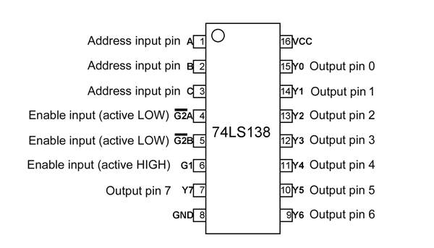
Project components
74LS138
A decoder that selects one of its eight outputs based on binary input, providing efficient signal decoding in digital systems and offering versatile output control in various electronic applications.
74LS74
dual D-type flip-flop chip used for storing a single bit of data in digital circuits, crucial for temporary data storage in various electronic applications.
74LS83
4-bit binary adder chip, enabling addition operations on four-bit binary numbers in digital circuits, ideal for arithmetic calculations in various applications.
Logic Function
AND, OR, NOT, XOR (Exclusive OR), NAND, NOR, XNOR (Exclusive NOR).

Slide 9
Project components
74LS138
A decoder that selects one of its eight outputs based on binary input, providing efficient signal decoding in digital systems and offering versatile output control in various electronic applications.
74LS74
dual D-type flip-flop chip used for storing a single bit of data in digital circuits, crucial for temporary data storage in various electronic applications.
74LS83
4-bit binary adder chip, enabling addition operations on four-bit binary numbers in digital circuits, ideal for arithmetic calculations in various applications.
Logic Function
AND, OR, NOT, XOR (Exclusive OR), NAND, NOR, XNOR (Exclusive NOR).

Slide 10
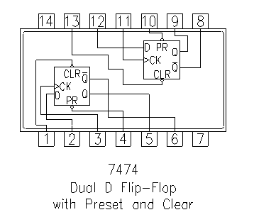
Project components
74LS138
A decoder that selects one of its eight outputs based on binary input, providing efficient signal decoding in digital systems and offering versatile output control in various electronic applications.
74LS74
dual D-type flip-flop chip used for storing a single bit of data in digital circuits, crucial for temporary data storage in various electronic applications.
74LS83
4-bit binary adder chip, enabling addition operations on four-bit binary numbers in digital circuits, ideal for arithmetic calculations in various applications.
Logic Function
AND, OR, NOT, XOR (Exclusive OR), NAND, NOR, XNOR (Exclusive NOR).

Slide 11
Project components
74LS74
dual D-type flip-flop chip used for storing a single bit of data in digital circuits, crucial for temporary data storage in various electronic applications.
74LS138
A decoder that selects one of its eight outputs based on binary input, providing efficient signal decoding in digital systems and offering versatile output control in various electronic applications.
74LS83
4-bit binary adder chip, enabling addition operations on four-bit binary numbers in digital circuits, ideal for arithmetic calculations in various applications.
Logic Function
AND, OR, NOT, XOR (Exclusive OR), NAND, NOR, XNOR (Exclusive NOR).

Slide 12
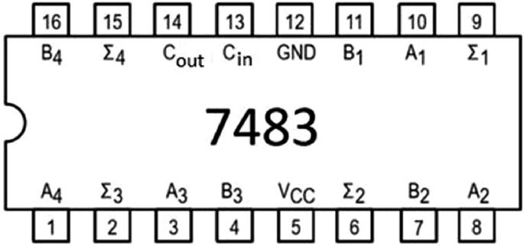
Project components
74LS138
A decoder that selects one of its eight outputs based on binary input, providing efficient signal decoding in digital systems and offering versatile output control in various electronic applications.
74LS74
dual D-type flip-flop chip used for storing a single bit of data in digital circuits, crucial for temporary data storage in various electronic applications.
74LS83
4-bit binary adder chip, enabling addition operations on four-bit binary numbers in digital circuits, ideal for arithmetic calculations in various applications.
Logic Function
AND, OR, NOT, XOR (Exclusive OR), NAND, NOR, XNOR (Exclusive NOR).

Slide 13
Project components
74LS83
4-bit binary adder chip, enabling addition operations on four-bit binary numbers in digital circuits, ideal for arithmetic calculations in various applications.
74LS138
A decoder that selects one of its eight outputs based on binary input, providing efficient signal decoding in digital systems and offering versatile output control in various electronic applications.
74LS74
dual D-type flip-flop chip used for storing a single bit of data in digital circuits, crucial for temporary data storage in various electronic applications.
Logic Function
AND, OR, NOT, XOR (Exclusive OR), NAND, NOR, XNOR (Exclusive NOR).

Slide 14
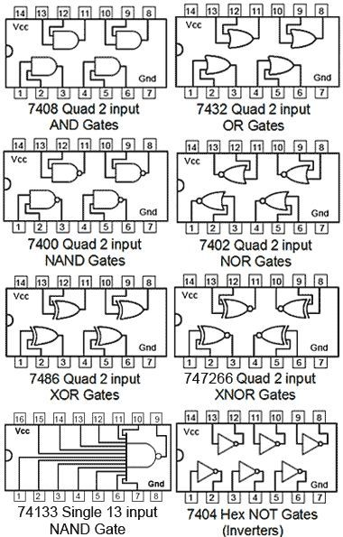
Project components
74LS138
A decoder that selects one of its eight outputs based on binary input, providing efficient signal decoding in digital systems and offering versatile output control in various electronic applications.
74LS74
dual D-type flip-flop chip used for storing a single bit of data in digital circuits, crucial for temporary data storage in various electronic applications.
74LS83
4-bit binary adder chip, enabling addition operations on four-bit binary numbers in digital circuits, ideal for arithmetic calculations in various applications.
Logic Function
AND, OR, NOT, XOR (Exclusive OR), NAND, NOR, XNOR (Exclusive NOR).

Slide 15
Project components
Logic Function
AND, OR, NOT, XOR (Exclusive OR), NAND, NOR, XNOR (Exclusive NOR).
74LS138
A decoder that selects one of its eight outputs based on binary input, providing efficient signal decoding in digital systems and offering versatile output control in various electronic applications.
74LS74
dual D-type flip-flop chip used for storing a single bit of data in digital circuits, crucial for temporary data storage in various electronic applications.
74LS83
4-bit binary adder chip, enabling addition operations on four-bit binary numbers in digital circuits, ideal for arithmetic calculations in various applications.

Slide 16
Project components
1-an 8 bit ALU
2-controlling it using a keypad
74LS138
A decoder that selects one of its eight outputs based on binary input, providing efficient signal decoding in digital systems and offering versatile output control in various electronic applications.
74LS74
dual D-type flip-flop chip used for storing a single bit of data in digital circuits, crucial for temporary data storage in various electronic applications.
74LS83
4-bit binary adder chip, enabling addition operations on four-bit binary numbers in digital circuits, ideal for arithmetic calculations in various applications.
Logic Function
AND, OR, NOT, XOR (Exclusive OR), NAND, NOR, XNOR (Exclusive NOR).
3-displaying the results
Future work

Slide 17
Program usage
Future work
1-an 8 bit ALU
To transform a 4-bit register into an 8-bit register, you need to add four more bits to the existing register. This can be achieved by concatenating four additional bits to the original 4-bit data.
That means we need to use 4 more 7474 chips for the register as well as on more 7483 and double the number of the logic gates.
We need to Connect the C-out (carry-out) of the first 7483 to the C-in (carry-in) of the second 7483.
2-controlling it using a keypad
74LS138
A decoder that selects one of its eight outputs based on binary input, providing efficient signal decoding in digital systems and offering versatile output control in various electronic applications.
74LS74
dual D-type flip-flop chip used for storing a single bit of data in digital circuits, crucial for temporary data storage in various electronic applications.
74LS83
4-bit binary adder chip, enabling addition operations on four-bit binary numbers in digital circuits, ideal for arithmetic calculations in various applications.
Logic Function
AND, OR, NOT, XOR (Exclusive OR), NAND, NOR, XNOR (Exclusive NOR).
3-displaying the results

Slide 18
Future work
1-an 8 bit ALU
To transform a 4-bit register into an 8-bit register, you need to add four more bits to the existing register. This can be achieved by concatenating four additional bits to the original 4-bit data.
That means we need to use 4 more 7474 chips for the register as well as on more 7483 and double the number of the logic gates.
We need to Connect the C-out (carry-out) of the first 7483 to the C-in (carry-in) of the second 7483.
Some airlines offer even further filters on the flights and the flight preparation to include all the changes that the clients wants to make
We can also apply these new filters depending on the airline company because the filters may differentiate between a company and another
2-controlling it using a keypad
3-displaying the results

Slide 19
To transform a 4-bit register into an 8-bit register, you need to add four more bits to the existing register. This can be achieved by concatenating four additional bits to the original 4-bit data.
That means we need to use 4 more 7474 chips for the register as well as on more 7483 and double the number of the logic gates.
We need to Connect the C-out (carry-out) of the first 7483 to the C-in (carry-in) of the second 7483.
Program usage
Future work
1-working on expanding it to an 8 bit ALU
Connect the rows and columns of the keypad to the appropriate pins on the 74C922 IC.
This step enhance the program even more due to it being easier to use by the user.
2-controlling it using a keypad
3-displaying the results

Slide 20
Future work
1-an 8 bit ALU
Connect the rows and columns of the keypad to the appropriate pins on the 74C922 IC.
This step enhance the program even more due to it being easier to use by the user.
2-controlling it using a keypad
3-displaying the results

Slide 21
Connect the rows and columns of the keypad to the appropriate pins on the 74C922 IC.
This step enhance the program even more due to it being easier to use by the user.
Program usage
Future work
1-working on expanding it to an 8 bit ALU
• Connect the outputs of your decoder (which represent the binary-coded decimal or other code for each digit) to the inputs of the seven-segment display.
• If you have multiple seven-segment displays to show multi-digit numbers, you might need to implement multiplexing. In this case, rapidly cycle through the displays and update the segments for each digit.
2-controlling it using a keypad
3-displaying the results

Slide 22
Future work
1-an 8 bit ALU
• Connect the outputs of your decoder (which represent the binary-coded decimal or other code for each digit) to the inputs of the seven-segment display.
• If you have multiple seven-segment displays to show multi-digit numbers, you might need to implement multiplexing. In this case, rapidly cycle through the displays and update the segments for each digit.
2-controlling it using a keypad
3-displaying the results
3-implementing more related procedures

Slide 23
• Connect the outputs of your decoder (which represent the binary-coded decimal or other code for each digit) to the inputs of the seven-segment display.
• If you have multiple seven-segment displays to show multi-digit numbers, you might need to implement multiplexing. In this case, rapidly cycle through the displays and update the segments for each digit.
Future work
Thank you!!
1-working on expanding it to an 8 bit ALU
2-controlling it using a keypad
3-displaying the results

Slide 24
Future work
Thank you!!
1-expand the list of destinations
2-applying more filters
3-implementing more related procedures

